Slide 1
Arup University Masters
Machine Learning and Artificial Intelligence Module
Notes:
0-05 Rene Welcome

Slide 2
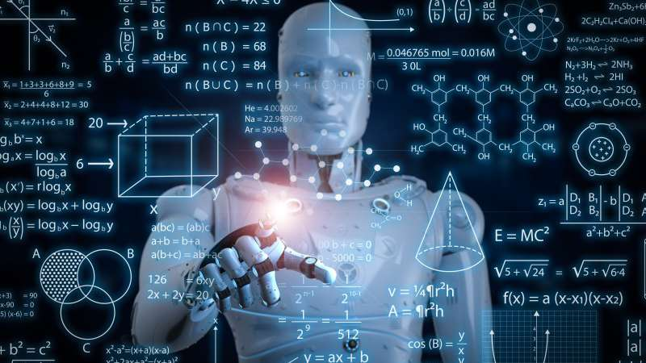
Welcome
Notes:
05-08
3 min Rene ; brief intro’s of faculty and who are joining/
Welcome everyone to the first Module of ML/AI Masters
From now on we will be meeting you over a number of weeks on Tuesdays and Thursdays.
Today you will have 2 live webinars.
This is the first one. The welcoming session. It takes 45 minutes.
What to expect from this session:
We explain a bit more about the learning investment, the agenda, learning tools and best practices and how we engage over the next weeks.
On the call me today: Tom Heath, Rory McCully Hannah Tester and Rene Boessen. After the opening session you will have new session with Volker Buscher.
Introduce 3 people from the participants, who are you, what is the weather there what time is it.
And now a quiz..

Slide 3

Quiz
Remote working
Notes:
08-13
5 min Rene
This Masters is remote and there is a good reason for it.
Let's run a quiz, see what you know about remote "learning" and some pay offs.

Slide 4
What percentage of participants on a conference call are less likely to multitask with their camera on?
A: 32%
B: 51%
C: 82%
Notes:
Question 1...
What percentage of participants on a conference call are less likely to multitask with their camera on? Source A: 32% B: 51% C: 82%*
So keep your cams on☺
Approximately how many tons of carbon emissions are reduced thanks to remote work? Source A: 1.2 million tons B: 2.2 million tons C: 2.9 million tons D: 3.6 million tons*
(so we support SDG’s ☺
77% of remote employees say they’re more productive when working from home. True or false? Source A: True* B: False
99% of workers said they’d prefer working remotely, at least some of the time, for the rest of their careers. True or false? Source A: True* B: False
If you are interested this is the website for icebreakers in a VC.
https://blog.sli.do/virtual-icebreakers/

Slide 5
What percentage of participants on a conference call are less likely to multitask with their camera on?
A: 1.2 million tons
B: 2.9 million tons
C: 3.6 million tons
Notes:
5 min Rene – Hannah supports
Approximately how many tons of carbon emissions are reduced thanks to remote work? Source A: 1.2 million tons B: 2.2 million tons C: 2.9 million tons D: 3.6 million tons*
(so we support SDG’s ☺
77% of remote employees say they’re more productive when working from home. True or false? Source A: True* B: False
99% of workers said they’d prefer working remotely, at least some of the time, for the rest of their careers. True or false? Source A: True* B: False
If you are interested this is the website for icebreakers in a VC.
https://blog.sli.do/virtual-icebreakers/

Slide 6
77% of remote employees say they’re more productive when working from home.
True or false?
A: True
B: False
Notes:
77% of remote employees say they’re more productive when working from home. True or false? Source A: True* B: False
99% of workers said they’d prefer working remotely, at least some of the time, for the rest of their careers. True or false? Source A: True* B: False
If you are interested this is the website for icebreakers in a VC.
https://blog.sli.do/virtual-icebreakers/

Slide 7
99% of workers said they’d prefer working remotely, at least some of the time, for the rest of their careers.
True or false?
A: True
B: False
Notes:
99% of workers said they’d prefer working remotely, at least some of the time, for the rest of their careers. True or false? Source A: True* B: False
If you are interested this is the website for icebreakers in a VC.
https://blog.sli.do/virtual-icebreakers/
Rene ask 2 more people who they are, where they are and what the weather is like there?

Slide 8

Learning Outcomes
By the end of the programme you will be an “integrator” who
Understands core concepts and methods in ML / AI, and how these are being applied to generate value at Arup and in related companies / industries.
Is clear about, and can communicate, how ML / AI fit within Arup's broader strategic direction, including many aspects of our digital transformation.
Can translate client problems and requirements into potential ML / AI solutions, reason about and navigate the technical challenges the solution may present, and make a broad assessment of feasibility.
Understands and can apply the core elements of an ML / AI workflow, including data acquisition, method selection, and evaluation.
Can evaluate the potential of a solution to create repeatable value from ML / AI methods, e.g. through automation and / or product and service development.
Understands and can apply core legal and ethical concepts related to ML / AI methods and applications.
Is able to support clients and colleagues in understanding how to derive greater value from ML / AI, and influence the ongoing progress of the firm in this area.
The purpose of the course is not to create practitioners but developing skills and knowledge needed in your role as integrator. Rather than deeply focus on tools and techniques, it will provide baseline knowledge of common technologies. As a result of this course people will be able to provide examples of successful application of ML&AI in and by Arup.
Notes:
13-18
Tom or Rory: 5 min Explain briefly the Learning Outcomes of the MM and how the programme addresses these

Slide 9

Masters Agenda
Monday | Tuesday | Wednesday | Thursday | Friday
Self Study | Live Webinars | Self Study s | Live Webinars | Self Study
Meet your fellow students
This Photo by Unknown Author is licensed under CC BY-SA-NC
Notes:
18-22
Rene 4 minutes
This is the overall agenda to share the expectations we have of participants of a Masters
Please be aware that the end of each week we organize a session for you to share observations, feedback, questions or comments. Questions for these sessions and all question you have please post them in the questions channel on Teams. Faculty is looking at the posted questions. These review sessions are 45 min time slots. Only in week 1 so this week we are doing it a bit different. We have 4 recorded bursts about AI/ML applications in Arup that we will share with you as homework and we are inviting the speakers Zoe Web, Brett Davis, Paul Lynch and Erica Levine to answer all your questions in a live session.
In this schedule you cannot see any breaks but through the schedule regular coffee breaks will be organized, of course you need to get the coffee and tea for yourself.
We are in a virtual environment. Please follow some ground rules:
No double tasking,
Webcams on during live events,
be on time after breaks and at start,
follow the instructions for break out rooms Hannah will be giving to you. This is important to make sure we have a smooth session.
Any questions during or after use the chat function and/or raise hand in teams.
IT ONLY WORKS WHEN YOU ENGAGE AND INVOLVE
Session will be recorded
Meeting your fellow students is key to build a global cohort and start becoming a member of a big network, do not forget that there are 2 sub teams making up 1 global cohort. Try to use a much as possible opportunities to meet your fellow students online.
Rene ask 2 more students where they are and what their discipline is.

Slide 10


Learning Tools
Notes:
25-26
Rene
We designed a tool to support your study process and have you reflecting how the learning will help you grow in your career and activities. It also is a face book, arup style. If you have not make yourself familiar with it and use it either online or as printed copy.
Now over to Hannah and Teams/Moodle before we do a test team activity.

Slide 11
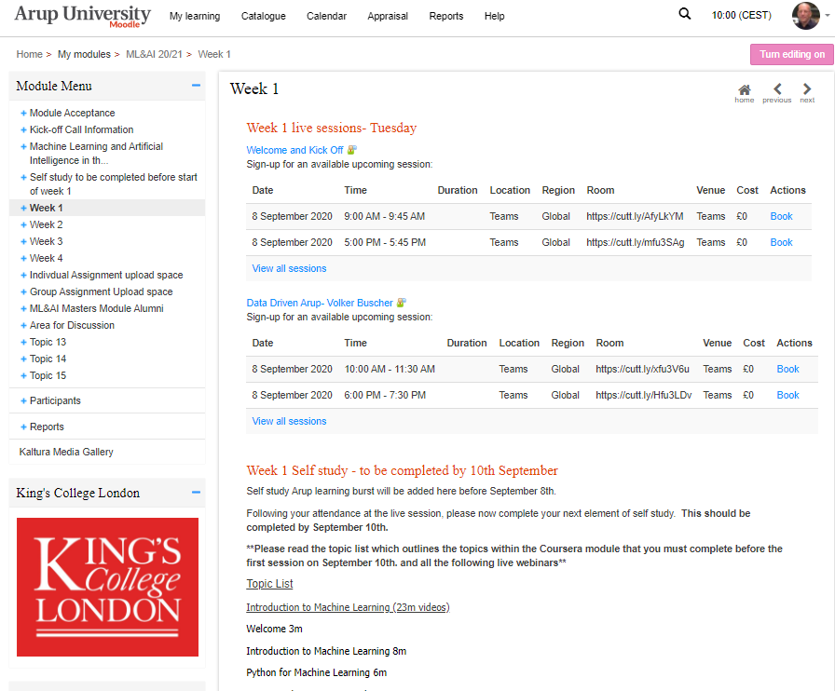
Moodle and Teams
Details available in Moodle
Book the Live Webinars for all weeks
Sessions will be recorded
Online feedback form after each week
How we use Teams
Question and discussions
Notes:
22-25
Hannah The agenda details and booking process in Moodle. And also explain how we use teams for study

Slide 12
Breakout rooms on Teams
A ‘Chair person’ will be assigned for each breakout room, it is there responsibility to click ‘meet now’ to start the break out room. The other members of the break out room will then click ‘join now’ in the specified break out room
Do not click ‘leave’ on the main plenary session when entering a break out room. When you enter the break out room the main session will just be put on hold so you can easily move between both
The break out rooms are not automatic so you will need to be aware of the time you enter and amount of time you should stay. Ensure you move back to the plenary session on time
If there is more than one break out activity in one session you will be assigned to the same room. You can leave this break out room active for the duration of the session by not leaving the call. It will simply put you on hold.

Slide 13
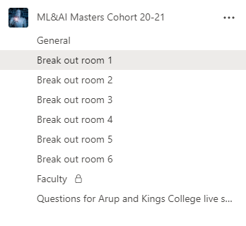
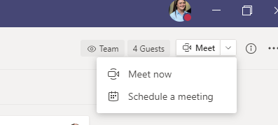
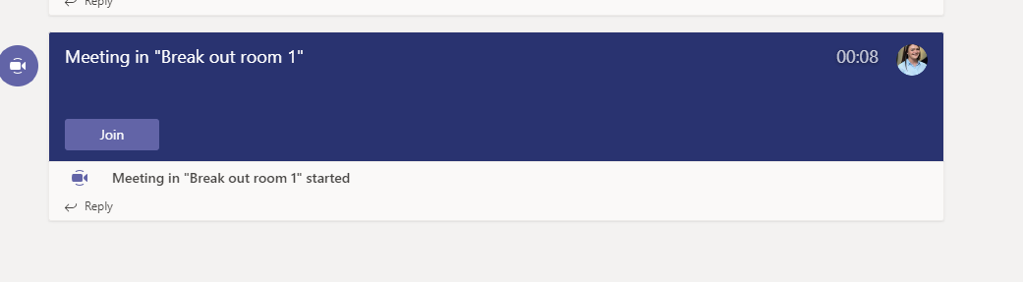
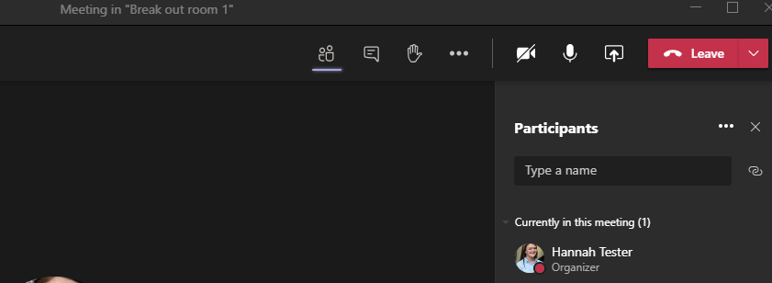




Breakout rooms on Teams
You will be assigned to one of the breakout rooms for the ML/AI Masters cohort
Each break out room will be assigned a ‘chair’ person. They will click ‘meet now’ in the specified breakout room to start the meeting
The other members of this group will then click ‘join’ in the specified breakout room
Do not click leave on either the plenary session or the breakout room, you can simply move between both by being put on ‘hold’

Slide 14
Breakout rooms on Teams
Breakout room 1
Chair- Kayum Khan
Alistair Sargeant
Jake Haskell
Breakout room 2
Chair- Aifric Delahunty
Joost Schlebaum
Thomas Luk
Breakout room 3
Chair- Sebastian Bukowski
Beccie Drake
Ronan O’Byrne
Breakout room 4
Chair- Sam Leaver
Matteo Orlandi
Huu Nguyen Le
Breakout room 5
Chair- Neil Montague
Tom Casey
John Kuyt

Slide 15
Introductions – Cohort
1 min interview each, 3 people per room
Interviewer , Observer, Interviewee
What would you ask?
Notes:
26-30
Activity to test the break out function and explain how it will work from now on. We make this a cohort building session. 1 interviews the other observes, each of you take each roles for 1 minutes so everyone is interviewer interviewed and observer.
Ask any questions you would normally ask when you are getting your first coffee or tea break in a classroom. My question would be where are you from….

Slide 16

Notes:
30 34 rene pick a few people to report back

Slide 17

Share experiences and best practices Self-study Studying @home
Notes:
Now lets plenary share some best practices. Use hand up or questions in Teams.
Any best practice to share with your fellow students.
How if studying at home in your situation
How are you ensuring you can attend all live webinars
Have you used the question channel already
What make remote learning difficult for you, or just easy What do you expect from the next session?
Now we have a 15 minute coffee break. Be aware to use the NEW link in teams, it is a new room. And be in time we start punctually.

